Slide 1

Amazon SALES data analysis
Sql capstone project by - purva vyas

Slide 2
introduction
The aim of this project is to gain insight into the sales data of Amazon to understand the different factors that affect sales of the different branches.
Dataset Overview: This dataset contains sales transactions from three different branches of Amazon, respectively located in Mandalay, Yangon and Naypyitaw. The data contains 17 columns and 1000 rows.
Tools Used: Excel, SQL

Slide 3
Approach Used
Data Wrangling: Build Database. Created Table and inserted values. Set the columns to Not Null to filter out null values.
Feature Engineering: Created few columns timeofday - to analyze which part of day most sales are made. dayname – to know on which week of the day each branch is busiest. monthname – to know which month of the year has the most sales and profit.
Exploratory Data Analysis (EDA): Exploratory data analysis is done to answer the bussiness questions and aims of this project.

Slide 4



Analysis Framework
Product Analysis
Sales Analysis
Customer Analysis

Slide 5

Product Analysis
1. What is the count of distinct product lines in the dataset? 6
2. Which product line has the highest sales? Food and Beverages – 56144.96
3. Which product line incurred the highest Value Added Tax? Food and Beverages – 2673.56

Slide 6
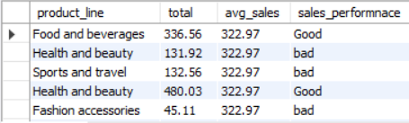
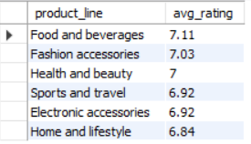
Product Analysis
4.For each product line, add a column indicating "Good" if its sales are above average, otherwise "Bad.“
5. Which product line is most frequently associated with each gender? Female- Fashion accessories – 96 Male- Health and beauty – 88
6. Calculate the average rating for each product line.

Slide 7
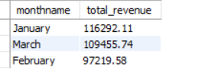

Sales Analysis
1.What is the count of distinct cities in the dataset? 3
2. For each branch, what is the corresponding city? A – Yangon B – Mandalay C – Naypyitaw
3.How much revenue is generated each month?
4.In which month did the cost of goods sold reach its peak? January – 110754.16

Slide 8
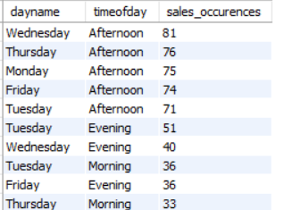
Sales Analysis
5.In which city was the highest revenue recorded? Naypyitaw – 110568.86
6. Identify the branch that exceeded the average number of products sold. A – 1859
7. Count the sales occurrences for each time of day on every weekday.
8. Determine the city with the highest VAT percentage. Naypyitaw – 5265.18

Slide 9
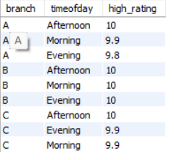
Sales Analysis
9. Identify the time of day when customers provide the most ratings. Afternoon – 528
10. Determine the time of day with the highest customer ratings for each branch.
12. Identify the day of the week with the highest average ratings. Monday – 7.15
13.Determine the day of the week with the highest average ratings for each branch. A – Friday – 7.31 B – Monday – 7.34 C – Friday – 7.28

Slide 10

Customer Analysis
1. .What is the count of distinct customer types in the dataset? 2
2. Identify the customer type contributing the highest revenue. Member – 164223.81
3. Identify the customer type with the highest VAT payments. Member – 7820.16
4.Which payment method occurs most frequently? Ewallet – 345
5. What is the count of distinct payment methods in the dataset? 3

Slide 11
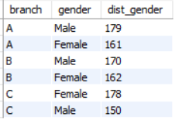
Customer analysis
6. Which customer type occurs most frequently? Member – 501
7. Identify the customer type with the highest purchase frequency. Member – 501
8.Determine the predominant gender among customers. Female – 501
9. Examine the distribution of genders within each branch.

Slide 12

Recommendations
Product Analysis: Focus on promoting the best performing product lines like “Food and Beverages” to increase revenue. Make marketing strategies for underperforming product lines like “Sports and Travel”, “Electronic Accessories”.
Sales Analysis: Increase stock availability and promotional offers during peak sales month (e.g. January). Explore strategies to boost sales in Mandalay, which showed lower revenue compared to other cities.
Customer Analysis: Target loyal customers of the "Membership" customer type with exclusive offers Design gender-specific campaigns to leverage the purchasing patterns identified in the analysis.

Slide 13
THANK YOU

